Slide 1
Catalan Numbers
Member: Chentian Wu, Austin Luo, Kaicheng Xue, Wenhan Zhang
Course: Math 473
School: University of Wisconsin-Madison

Slide 2
Outline
Rationale of Selection -- Austin
Overview -- Austin
General Formula -- Wenhan Zhang
Visualization of General Formula -- Wenhan Zhang
Recurrence Formula -- Wenhan Zhang
Generating Function -- Chentian Wu
Applications -- Kaicheng Xue
Notes:
Our presentation is separated into six sections and we will start with the rationale of selection.

Slide 3
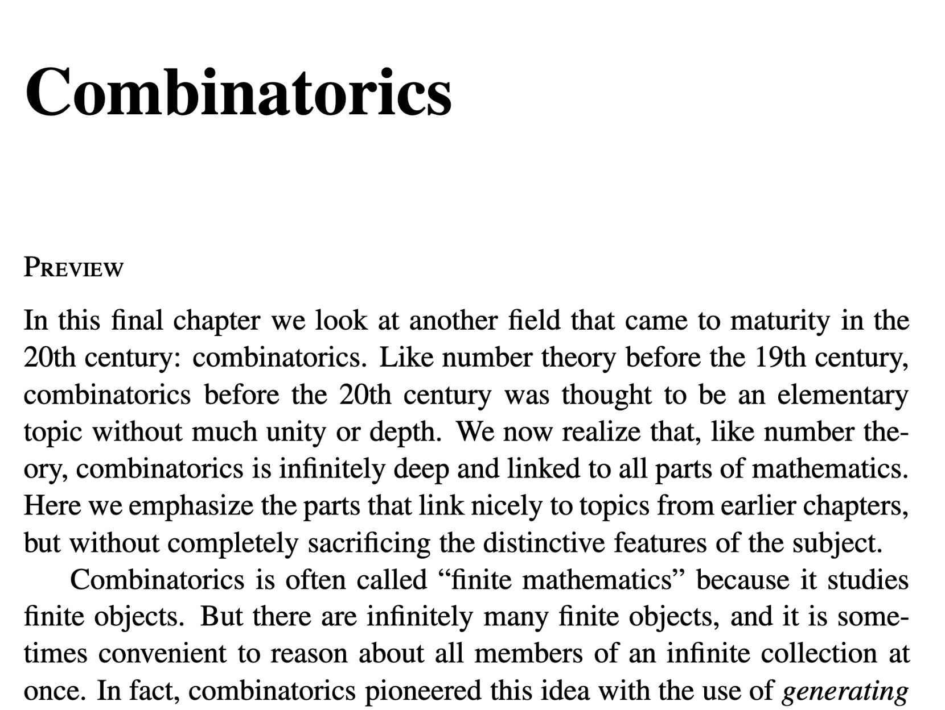
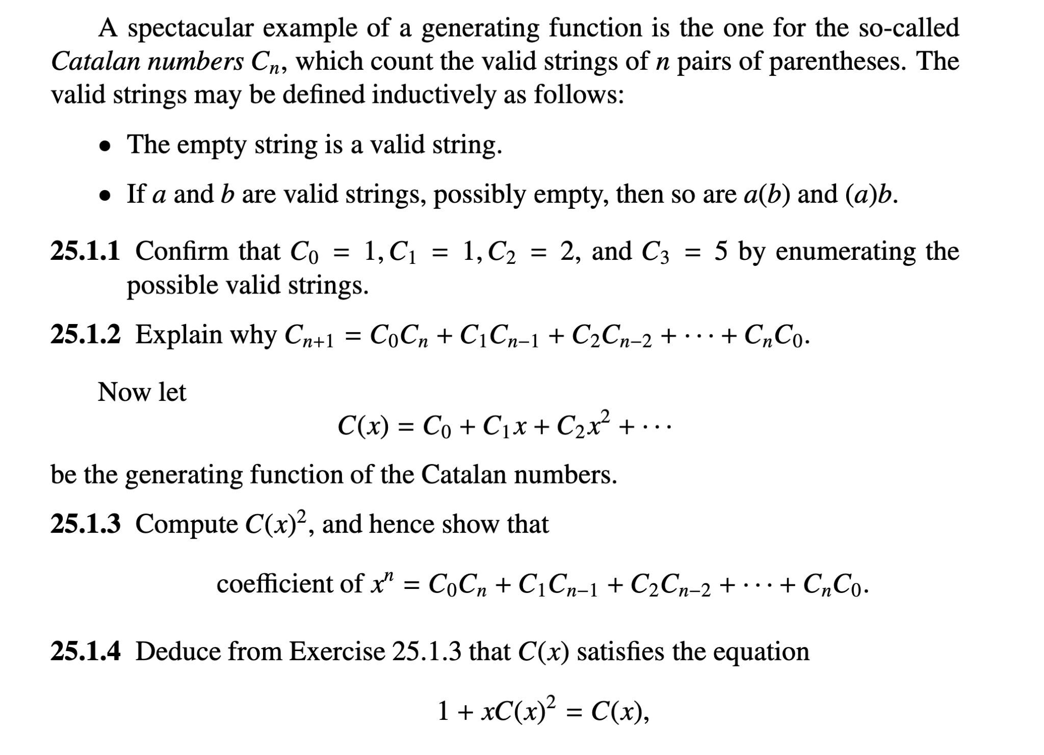
Rationale of Selection
Old Textbook:
Notes:
As for our rationale of selection, the old textbook of math 473 actually included Combinatorics and Catalan numbers but this topic is removed in the new textbook. So, we decided to introduce this really interesting topic due to its important role in combinatorics, the mathematics of counting and arranging.

Slide 4
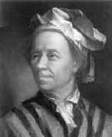
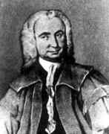
Overview
Leonhard Euler
Johann Andreas von Segner
Notes:
Catalan numbers were first discovered by Swiss mathematician Leonhard Euler and Hungarian mathematician Johann Andreas von Segner by studying the problem of triangulation of the convex polygon.

Slide 5
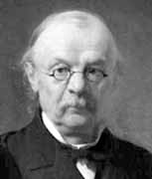
Overview
Eugène Charles Catalan
The first 10 Catalan numbers are (Importance: the first is C0)
𝐶𝑛 = {1, 1, 2, 5, 14, 42, 132, 429, 1430, 4862, 16796}
Notes:
Although recursive relations of these numbers are introduced from Segner, many of the properties and identities of these numbers are discovered by the side of French-Belgian mathematician Eugene Charles Catalan in 1838 through the study of well-formed sequences of parentheses.
The first 10 Catalan numbers are
𝐶𝑛 = {1, 1, 2, 5, 14, 42, 132, 429, 1430, 4862, 16796}. One thing to notice is that the first Catalan number C0 does not exist in real life but was set by mathematicians for the purpose of calculating C1. After adding in the C0, all the Catalan numbers can be calculated through a simple recurrence formula.

Slide 6
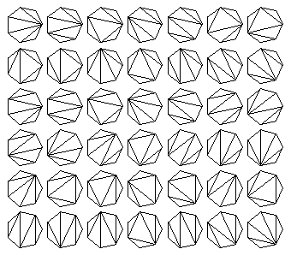
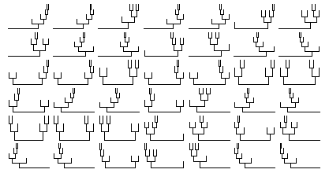
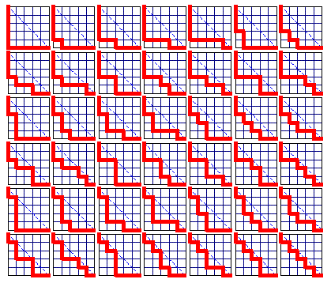
Significance of Catalan Numbers
polygon and polyhedron
binary trees
lattice path problem
Notes:
Catalan numbers have a significant place and major importance in combinatorics and computer science. They form a sequence of natural numbers that occur in studying astonishingly many combinatorial problems. Catalan numbers describe the number of ways a polygon with 𝑛+2 sides can be cut into 𝑛 triangles, the number of rooted, trivalent trees with n+1 nodes, the number of paths of length 2n through an n×n grid that do not rise above the main diagonal.

Slide 7
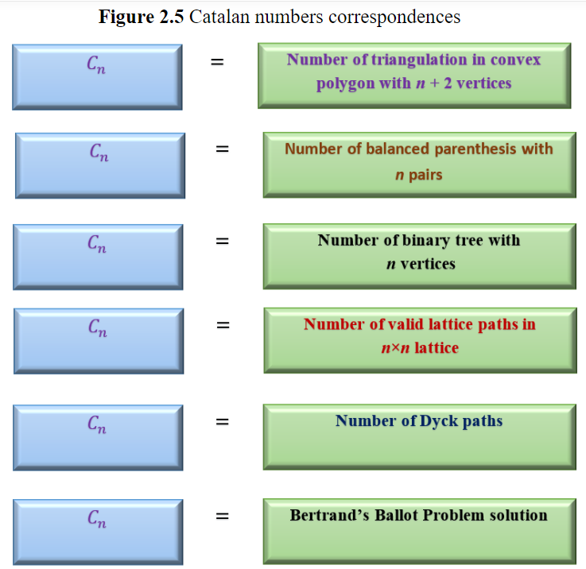
Significance of Catalan Numbers
Notes:
Here is a summary of the correspondences of Catalan numbers. Moreover, Catalan numbers also contributed to the study of computational geometry, which is a discipline of computer science that deals with the research of algorithms from the aspect of geometry.

Slide 8

General Formula

Slide 9
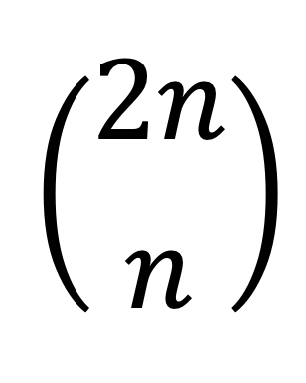
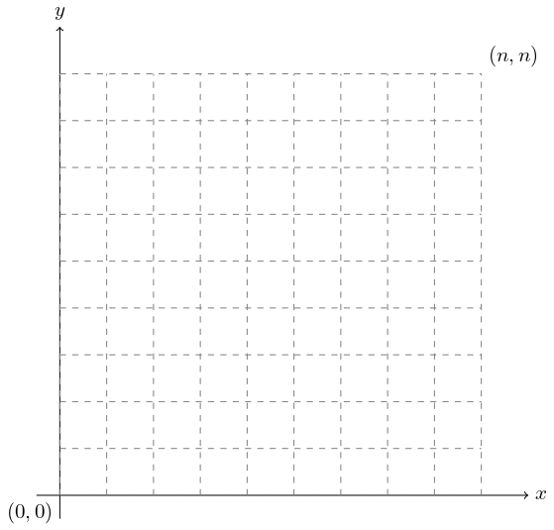
Visualization of
Suppose we have a n x n size lattice with a point initially located at (0,0). The point can move either upward or rightward by one unit each time. The final destination of this point is (n,n).

Slide 10
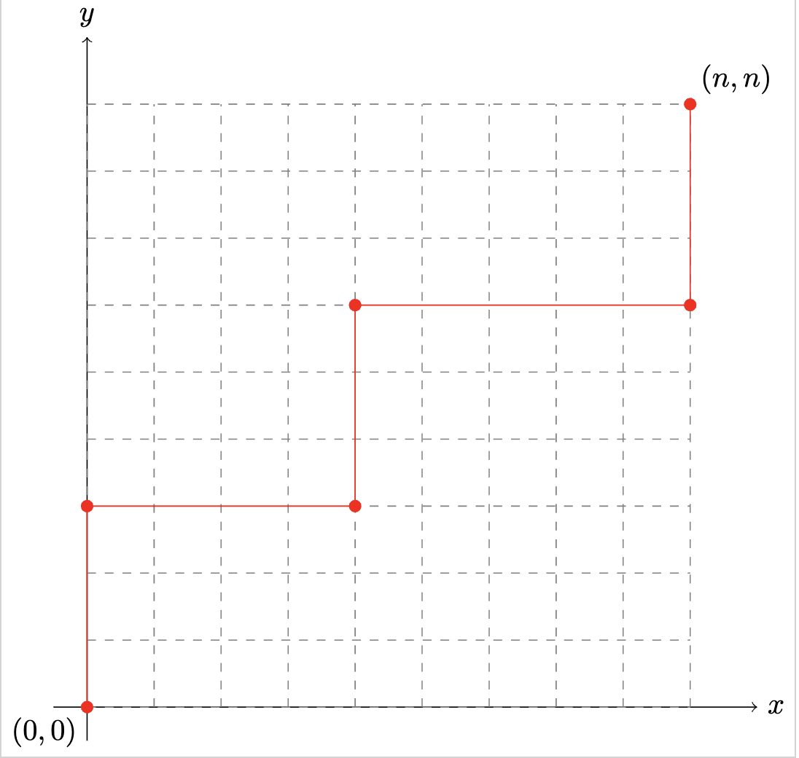
Visualization of
To reach (n,n), the point needs to move n units upward and n units rightward. So, from the total 2n moves, we need to have n upward moves. Hence, the number of paths we can have will be
.

Slide 11
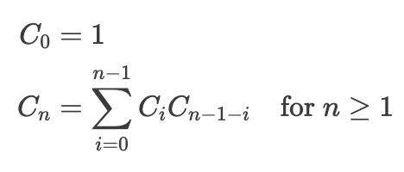
Recurrence Formula
Recurrence relation
for 𝐶𝑛:

Slide 12
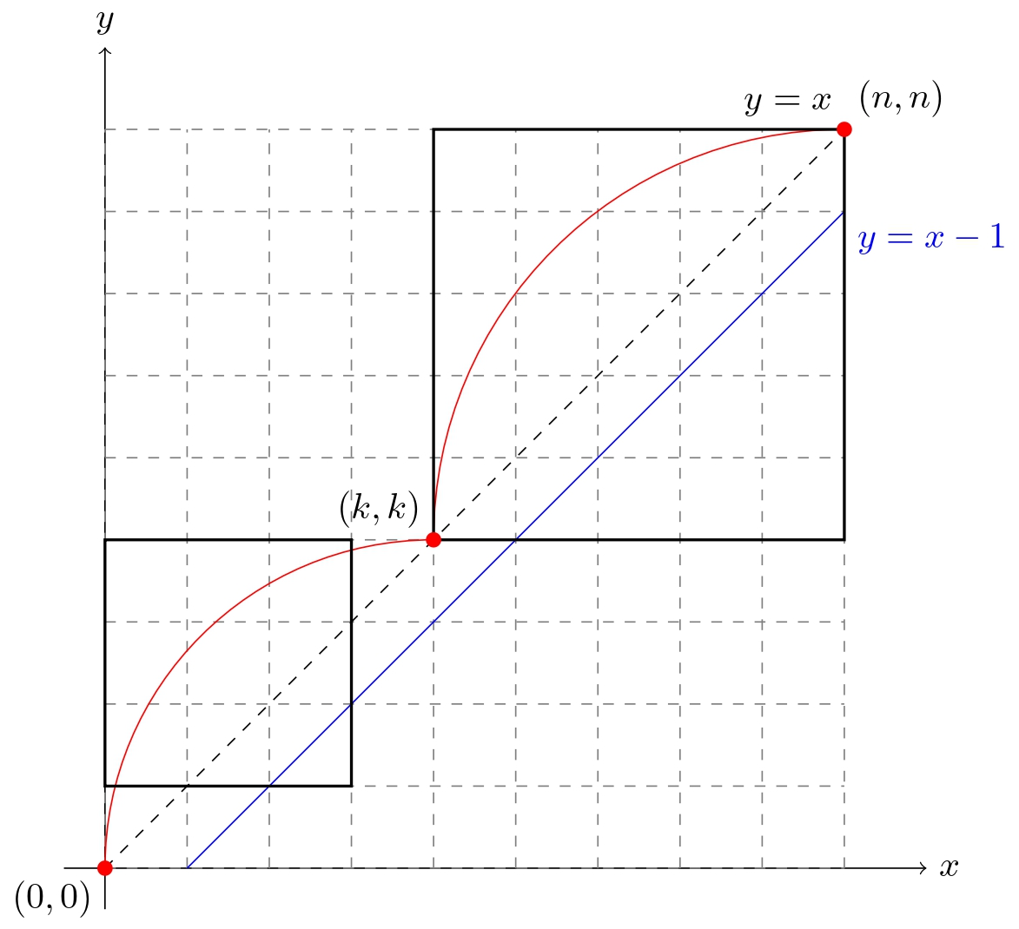
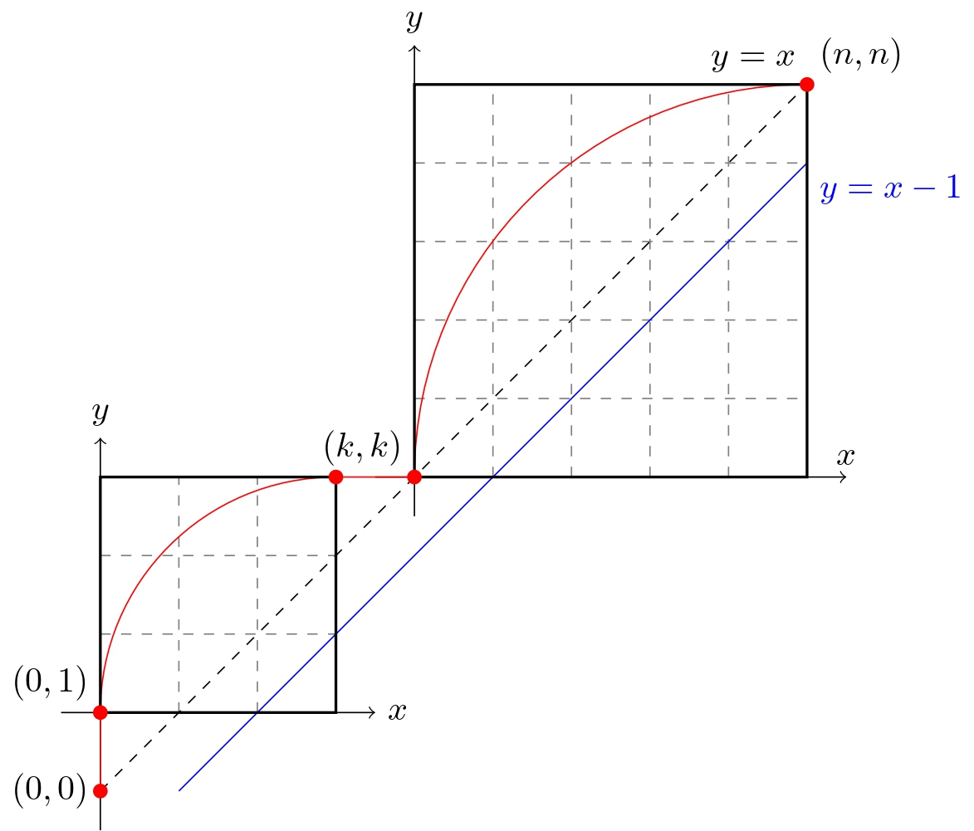
Visualization of Recurrence:

Slide 13


Two Subproblems:

Slide 14
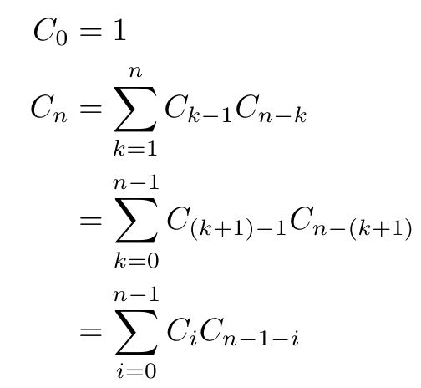
Recurrence Formula
Recurrence relation for 𝐶𝑛:

Slide 15
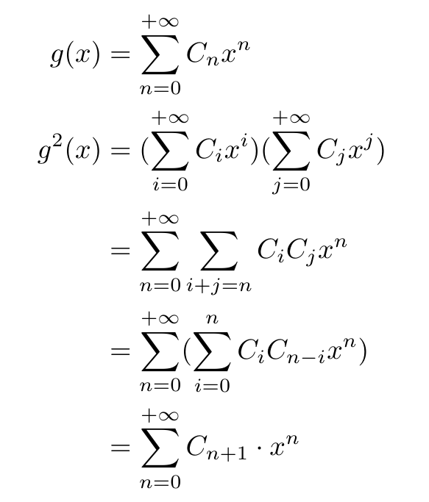

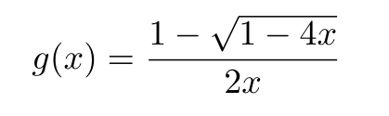
Generating Function:
We can also derive the general formula for Catalan Numbers by using the generating function of its recurrence formula.

Slide 16
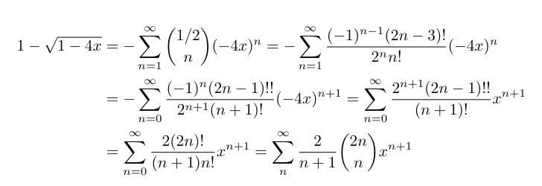

Generating Function:

Slide 17
Application:
There are 2n people in a line and an empty can. Each time, one person will either put a coin into the can or take a coin from the can. Suppose there are n people put a coin into the can (donor) and the other n people take a coin from the can (recipient). How many ways we can arrange the team to ensure every recipient can take away a coin?
: donor
: recipient
$
……

Slide 18
Solution:
Starts from (0,0) to (n,n) in coordinates, at a point (x,y)
: donor
y-coordinate
Move up; coin number +1
: recipient
x-coordinate
Move right; coin number -1
For point (x,y), number of coin in can: N = 1*y+(-1)*x = y-x
Nonnegative: N = y-x ≥ 0 → y ≥ x → y > x-1, no reach on y = x-1
Catalan Number problem

Slide 19
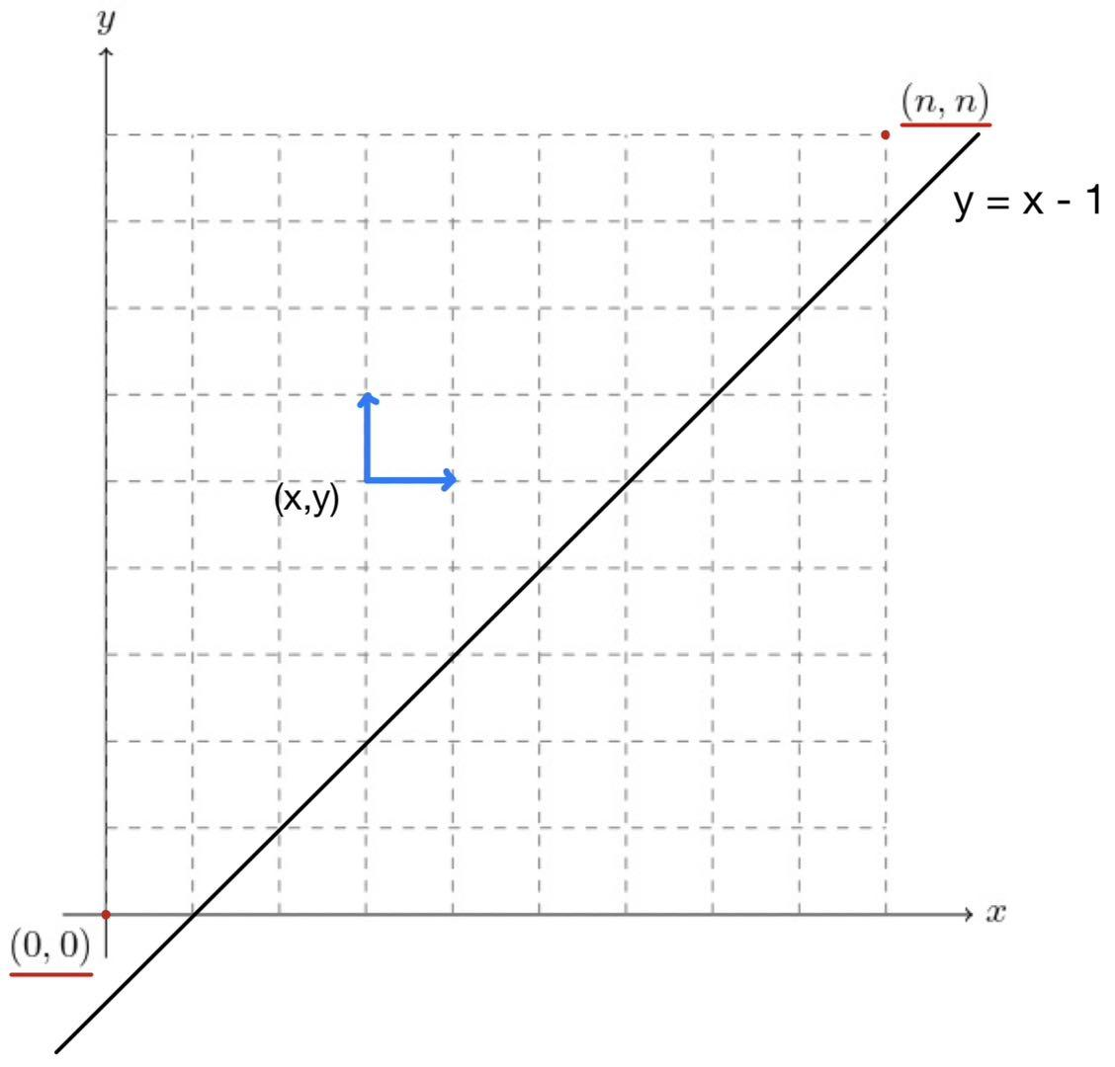

Slide 20
Works Cited
Selimi, Aybeyan, and Muzafer SARAČEVIĆ. “Catalan Numbers and Applications - Vision Journal.” Vision Journal, Mar. 2019, visionjournal.edu.mk/wp-content/uploads/2019/08/aybeyan-pdf.pdf.
O’Connor, J J, and E F Robertson. “Leonhard Euler - Biography.” Maths History, Sept. 1998, mathshistory.st-andrews.ac.uk/Biographies/Euler/.
O’Connor, J J, and E F Robertson. “Johann Segner - Biography.” Maths History, Mar. 2004, mathshistory.st-andrews.ac.uk/Biographies/Segner/.
O’Connor, J J, and E F Robertson. “Eugène Catalan - Biography.” Maths History, Sept. 2012, mathshistory.st-andrews.ac.uk/Biographies/Catalan/.
Dickau, Robert M, and Heinz Klaus Strick. “Catalan Numbers.” Maths History, mathshistory.st-andrews.ac.uk/Extras/Catalan/. Accessed 30 Apr. 2024.
Stillwell, John. Mathematics and Its History. Springer New York, 2010.

